Slide 1
Why Threads Are Bad Idea
&
Why Events Are Bad Idea
32151859 박재원

Slide 2
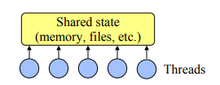
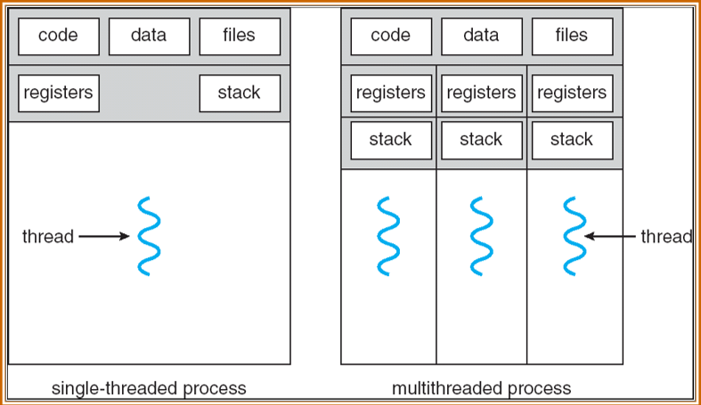
Why Threads Are A Bad Idea
(for most purposes)
What Are Threads?
General-purpose solution for managing concurrency.
Multiple independent execution streams.
Shared state.
Preemptive scheduling
Synchronization

Slide 3
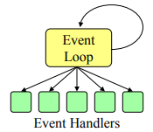
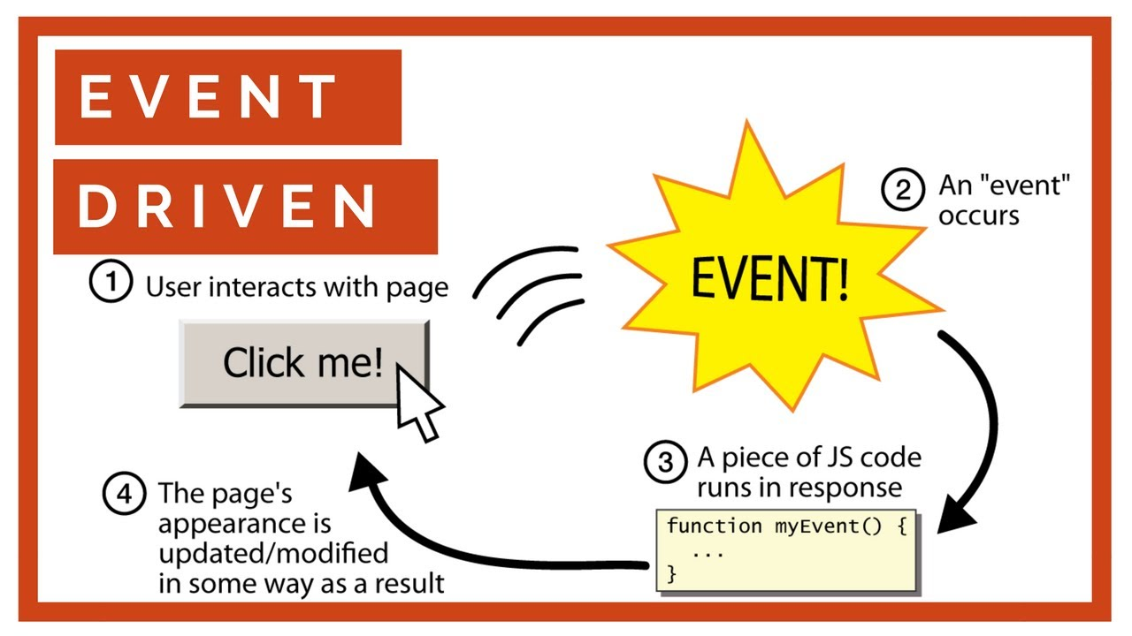
Why Threads Are A Bad Idea
(for most purposes)
What Are Event?
One execution stream: no CPU concurrency.
Register interest in events(callbacks).
Event loop waits for events, invokes handlers.
No preemption of event handler.
Handlers generally short-lived.

Slide 4

Why Threads Are A Bad Idea
(for most purposes)
Why Threads Are Hard
Synchronization
Deadlock
Hard to debug
Threads break abstraction
Callbacks don’t work with locks
Achieving good performance is hard
Threads not well supported
often don’t want concurrency anyway

Slide 5
Why Threads Are A Bad Idea
(for most purposes)
Problems With Events
Long-running handlers make application non-responsive
Can’t maintain local state across events (handler must return)
No CPU concurrency
Event-driven I/O not always well supported

Slide 6
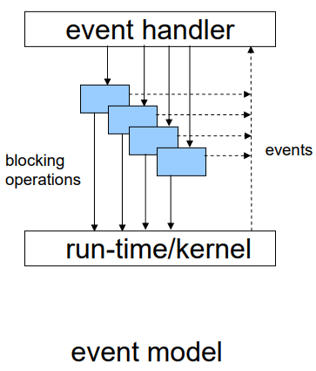
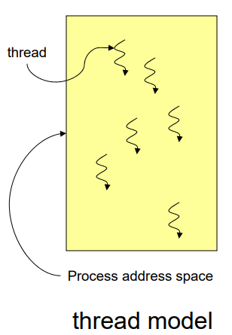
Why Threads Are A Bad Idea
(for most purposes)
Events vs Threads
Event avoid concurrency as much as possible, threads embrace
Debugging easier with events
Events faster than threads on single CPU
Events more portable than threads
Threads provide true concurrency
VS

Slide 7

Why Events Are A Bad Idea
(for high-concurrency servers)
Events vs Threads
(Duality Revisited)
The cooperative scheduling used by events for synchronization was ignored.
Most event systems use shared memory and global data structures(Except SEDA).
Suitable threads implementation for very high concurrency didn’t exist.
Criticisms of thread performance and usability are problems with specific threading
Notes:
(Duality Revisited)
The cooperative scheduling used by events for synchronization was ignored.
Most event systems use shared memory and global data structures(Except SEDA).
Suitable threads implementation for very high concurrency didn’t exist.
Criticisms of thread performance and usability are problems with specific threading.
(Problem with Thread)
Performance
None of the thread packages were designed for both high concurrency and blocking operation.
Control Flow
Complicated control flow patterns are rare in practice (Only call/return, parallel calls, pipelines are used).
Synchronization
An advantage through cooperative multitasking can be equally applied on thread systems.
State Management
Tradeoff between risking stack overflow and wasting virtual address space on large stacks can be solved by dynamic stack growth.
Scheduling
Cooperative scheduled threads can be applied scheduling tricks that same with event systems’.

Slide 8
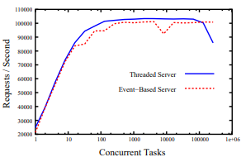
Why Events Are A Bad Idea
(for high-concurrency servers)
Events vs Threads
(Problem with Thread)
Performance
Control Flow
Synchronization
State Management
Scheduling
Notes:
(Problem with Thread)
Performance
None of the thread packages were designed for both high concurrency and blocking operation.
Control Flow
Complicated control flow patterns are rare in practice (Only call/return, parallel calls, pipelines are used).
Synchronization
An advantage through cooperative multitasking can be equally applied on thread systems.
State Management
Tradeoff between risking stack overflow and wasting virtual address space on large stacks can be solved by dynamic stack growth.
Scheduling
Cooperative scheduled threads can be applied scheduling tricks that same with event systems’.

Slide 9
Why Events Are A Bad Idea
(for high-concurrency servers)
The Case for Thread
two observation about modern servers
Control Flow
Exception Handling and State Life time
Existing Systems
Just Fix Events?
Notes:
two observation about modern servers
The concurrency in modern servers result from concurrent requests that are largely independent.
The code that handles each request is usually sequential.
Control Flow
Thread systems allow programmers to avoid “stack ripping (pairing call with return)”.
Exception Handling and State Life time
Cleaning up task state after exceptions and after normal termination is simpler in threaded system.
Existing Systems
The preference for threads is visible in existing event-driven systems because not only some parts are impossible to get correct behavior using event but thread is sometimes simpler.
Just Fix Events?
Fixing the problems with events is tantamount to switching to threads.

Slide 10
Why Events Are A Bad Idea
(for high-concurrency servers)
Compiler Support for Threads
Dynamic Stack Growth
Live State Management
Synchronization
Notes:
Dynamic Stack Growth
Mechanism that allows the size of the stack to be adjusted at run time allow to be avoid the tradeoff between potential overflow and wasted space associated with fixed-size stack.
Using a compiler analysis, providing an upper bound on the amount of stack space needed and determining which call sites may require stack growth become possible.
Live State Management
Compilers could easily purge unnecessary state from stack before making function calls.
Synchronization
Compile-time analysis reduces the occurrence of bugs by warning the programmer about data races.
Compiler analysis helps determine which atomic sections are safe to run concurrently.

Slide 11
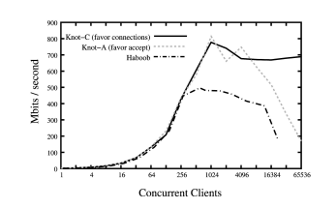
Why Events Are A Bad Idea
(for high-concurrency servers)
Evaluation
Knot
Thread package web server which uses the coro coroutine library, UNIX poll() system call
Haboob
SEDA’s event driven web server uses the UNIX poll() system call

Slide 12
Why Events Are A Bad Idea
(for high-concurrency servers)
Evaluation
Knot-A
Use natural throttling mechanism by limiting the number of new connection
Knot-C
Use natural throttling mechanism by limiting the number of new connection

Slide 13
Why Events Are A Bad Idea
(for high-concurrency servers)
Evaluation
Result
Haboob’ maximum bandwidth is significantly lower than Knot’s
Reasons
Requires a large number of context switches, module crossing and queuing operation.
Creates many temporary objects and relies heavily on garbage collection
Various forms of run-time dispatch cause ambiguous control flow.

Slide 14
Why Events Are A Bad Idea
(for high-concurrency servers)
Conclusion
Thread systems obtain better performance in high concurrency systems than event systems.
Thread systems provide simpler programming model and wealth of compiler analyses.

Slide 15
Why Events Are A Bad Idea
(for high-concurrency servers)
감사합니다

